Slide 1

Sniffers
19CSE335 Ethical Hacking

Slide 2
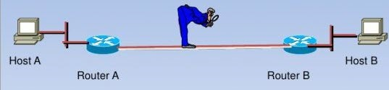
Sniffing: Introduction
Sniffing is a process of monitoring and capturing all data packets passing through a given network using sniffing tools.
Sniffing done using software that captures all data packets passing through a given network interface or by using hardware devices explicitly designed for this purpose.

Slide 3
What is sniffing software used for?
Ethical usage
Packet capturing
Network traffic usage and analysis
Packet conversion for data analysis
Network troubleshooting
Unethical usage
User identity and password stealing
Email or instant message data stealing
Packet spoofing and data theft
Monetary or reputational damage

Slide 4
How does sniffer works?
A network interface card (NIC) is a hardware component that contains a circuit board in every computer network.
Sniffing attacks require the NICs to be set to promiscuous mode, which allows the NICs to receive all network traffic.
Sniffers can listen in on all traffic passing through the NICs by decoding the encoded information in the data packets.
Sniffing attacks are made more accessible by weakly encrypted data packets.

Slide 5
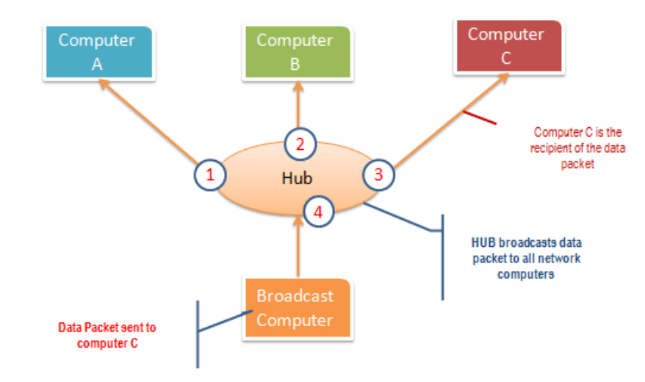
Type of sniffing: Passive sniffing
A hub works by sending broadcast messages to all output ports on it except the one that has sent the broadcast.

Slide 6
Type of sniffing: Passive sniffing
Passive sniffing means sniffing through a hub, on a hub the traffic is sent to all ports.
It involves only monitoring of the packets sent by others without sending any additional data packets in the network traffic.
In a network that use hubs to connect systems, all hosts on the network can see all traffic therefore attacker can easily capture traffic going through the hub.
This sort of passive sniffing is incredibly difficult to detect.
Hub usage is out-dated today. Most modern networks use switches.

Slide 7
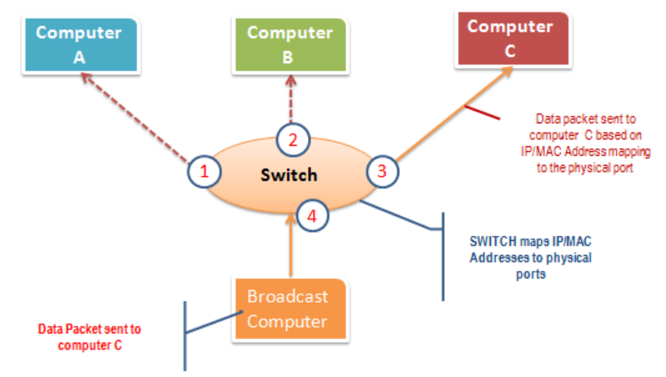
Type of sniffing: Active sniffing
A switch works differently; it maps IP/MAC addresses to physical ports on it.
Broadcast messages are sent to the physical ports that match the IP/MAC address configurations for the recipient computer.

Slide 8
Type of sniffing: Active sniffing
Sniffing in the switch is active sniffing.
The switch regulates the flow of data between its ports by actively monitoring the MAC address on each port, which helps it pass data only to its intended target.
In order to capture the traffic between target sniffers must actively inject traffic into the LAN to enable sniffing of the traffic.
Active sniffing involves injecting address resolution packets (ARP) into the network to flood the switch's Content Addressable Memory (CAM) table, CAM keeps track of which host is connected to which port.

Slide 9
Type of sniffing: Active sniffing
Active Sniffing Techniques:
MAC Flooding
DNS Poisoning
ARP Poisoning
DHCP Attacks
Switch Port Stealing
Spoofing Attack

Slide 10
ARP Poisoning
Address Resolution protocol (ARP)?
Is there someone with IP address 10.0.0.22, please send me your MAC. My MAC address 0053.ffff.aaaa
I’m 10.0.0.22.My MAC address is 0053.ffff.bbbb

Slide 11
ARP Poisoning
Address Resolution Protocol (ARP) is a stateless protocol used for resolving IP addresses to machine (MAC) addresses.
All network devices (that needs to communicate on the network) broadcasts ARP queries in the network to find out other machines' MAC addresses.
When one machine needs to communicate with another, it looks up its ARP table. If the MAC address is not found in the table, the ARP_REQUEST is broadcasted over the network.
All machines on the network will compare this IP address to their MAC address.
If one of the machine in the network identifies with this address, it will respond to ARP_REQUEST with its IP and MAC address. The requesting machine will store the address pair in the ARP table and communication will take place.

Slide 12
ARP Poisoning
The request response scheme of ARP protocols is arranged so that the first answer to an ARP request is accepted and stored.
There is no verification process of ARPs and therefore no way to tell if they are coming from a legitimate or corrupted source.
Applications will accept ARP responses most of the time, even if they have never sent out a prior request.
The lack of security leaves room for ARP poisoning, where attackers can intercept and tamper with communications.

Slide 13
ARP Poisoning
ARP poisoning, or ARP spoofing, is where a bad actor situates themselves in the middle of all communications between the application and network.
Hackers try to preempt the actual target computer in order to send a reply packet with incorrect information and manipulate the ARP table of the inquiring computer called ARP poisoning.
As a rule, these data packets contain the MAC address of a network device being controlled by hackers.
The targeted system then links the output IP to the wrong hardware address and sends all future data packets to the hacker-controlled system.

Slide 14
Threats of ARP Poisoning
Once attackers have access to the system, they can roam around freely, intercepting all communications between the network and the application.
The threats of ARP poisoning include:
Denial-of-Service (DoS) Attack - to overwhelm a system
Sending numerous IP addresses to one application at one time essentially crashes the system, bombarding it with traffic that it cannot keep up with.
Session Hijacking – Attackers can capture the session ID
If attackers intercept the session ID after gaining access into the network via ARP poisoning, they can easily gain access to other accounts in which the user is still authenticated.

Slide 15
Threats of ARP Poisoning
Man-in-the-middle attack- To intercept incoming traffic from a legitimate user and modify it to gain access to the session.
Other threats include Data Interception, Connection Hijacking, Connection Resetting, Stealing Passwords, manipulating data etc.

Slide 16
Countermeasures
Restrict the physical access to the network media to ensure that a packet sniffer cannot be installed.
Use encryption to protect confidential information.
Permanently add the MAC address of the gateway to the ARP cache.
Use static IP addresses and static ARP tables to prevent attackers from adding the spoofed ARP entries for machines in the network.
Use IPv6 instead of IPv4 protocol.

Slide 17
Countermeasures
Use encrypted sessions such as SSH instead of Telnet, Secure Copy (SCP) instead of FTP, SSL for email connection, etc. to protect wireless network users against sniffing attacks.
Use HTTPS instead of HTTP to protect usernames and passwords.
Use switch instead of hub as switch delivers data only to the intended recipient.
Use SFTP, instead of FTP for secure transfer of files.
Use PGP and S/MIPE, VPN, SSL/TLS, Secure Shell (SSH) and One-time passwords (OTP).

Slide 18
Countermeasures
Always encrypt the wireless traffic with a strong encryption protocol such as WPA and WPA2.
Retrieve MAC directly from NIC instead of OS; this prevents MAC address spoofing.
Use tools to determine if any NICs are running in the promiscuous mode.
Turn off network identification broadcasts and if possible, restrict the network to authorized users in order to protect network from being discovered with sniffing tools.

Slide 19
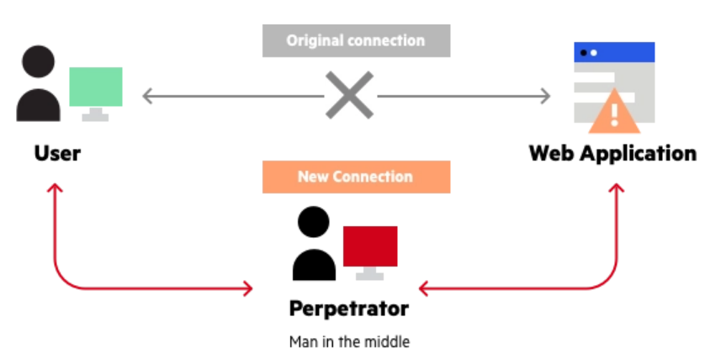
Man In the Middle Attacks
A man in the middle (MITM) attack is a general term for when a perpetrator positions himself in a conversation between a user and an application.

Slide 20
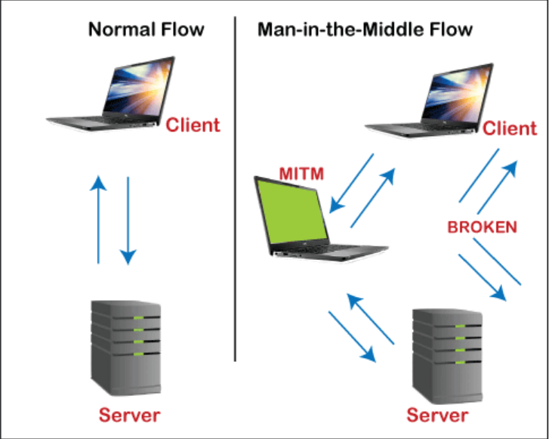
Real instance of MITM attack
The intruder positioned himself in between the client and server to intercept the confidential data or manipulate the incorrect information of them.

Slide 21
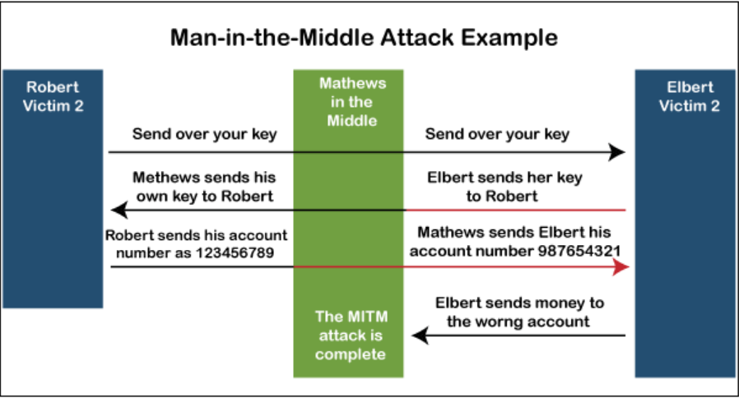
Another Instance of MITM attack

Slide 22
Key concept of MITM
Are a type of session hijacking
Involve attackers inserting themselves as relays or proxies in an ongoing, legitimate conversation or data transfer
Exploit the real-time nature of conversations and data transfers to go undetected
Allow attackers to intercept confidential data
Allow attackers to insert malicious data and links in a way indistinguishable from legitimate data

Slide 23
Types of MITM attack
There are two types of MITM attacks: passive attacks and active attacks
Passive attack - tacker receives the packets being transmitted and forwards them without making changes.
Active attacks - attacker receives the packets and manipulates them, then he forwards the manipulated packets.

Slide 24
Types of MITM attack
MITM execution has two distinct phases: interception and decryption.
IP spoofing
DNS Spoofing
ARP Spoofing
Wi-Fi Eavesdropping
SSL Stripping
HTTPS Spoofing
Interception
decryption

Slide 25
Interception
IP spoofing
Spoofing is an impersonation of a user, device or client on the Internet. It’s often used during a cyberattack to disguise the source of attack traffic.
Computer networks communicate through the exchange of network data packets, each containing multiple headers used for routing and to ensure transmission continuity.
One such header is the ‘Source IP Address’, which indicates the IP address of the packet’s sender.
In IP spoofing or IP address forgery, used to gain unauthorized access to machines, whereby an attacker illicitly impersonates another machine by manipulating IP packets.

Slide 26
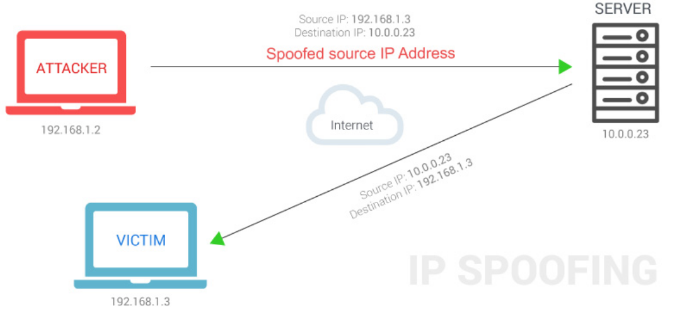
IP spoofing

Slide 27
IP spoofing
The intruder sends messages to a computer with an IP address indicating that the message is coming from a trusted host.
To engage in IP spoofing, a hacker must first use a variety of techniques to find an IP address of a trusted host and then modify the packet headers so that it appears that the packets are coming from that host.
When IP spoofing is used to hijack a browser, a visitor who types in the URL of a legitimate site is taken to a fraudulent Web page created by the hijacker.
If a user interacts with dynamic content on a spoofed page, the hijacker can gain access to sensitive information or computer or network resources.

Slide 28
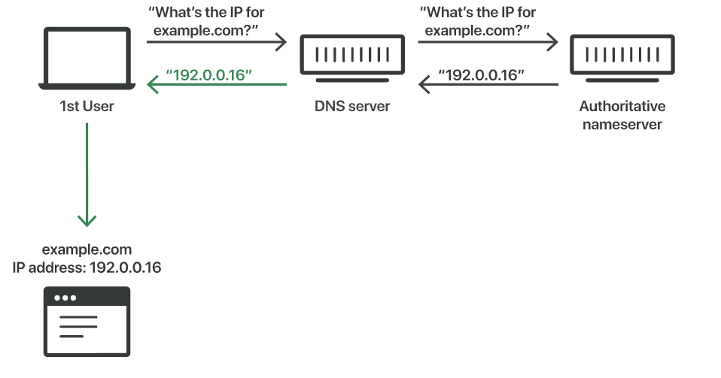
DNS spoofing
DNS resolvers provide clients with the IP address that is associated with a domain name.

Slide 29
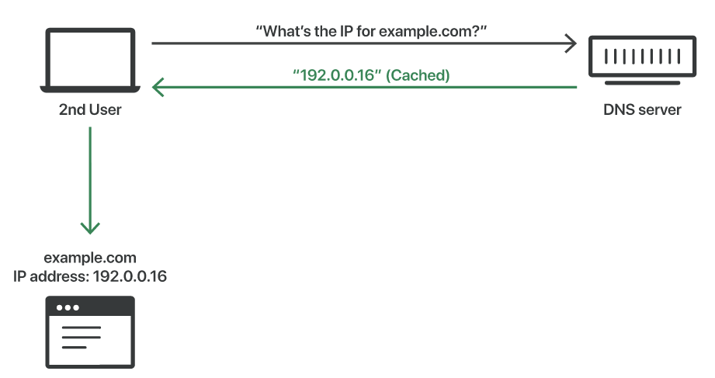
DNS spoofing
When a user attempts to navigate to a website, a request send to the DNS resolver.
The DNS resolver responds with the IP address, and the web browser takes this address and initiates loading the website.
A DNS resolver will save responses to IP address queries for a certain amount of time in the DNS cache.
DNS Cached response

Slide 30
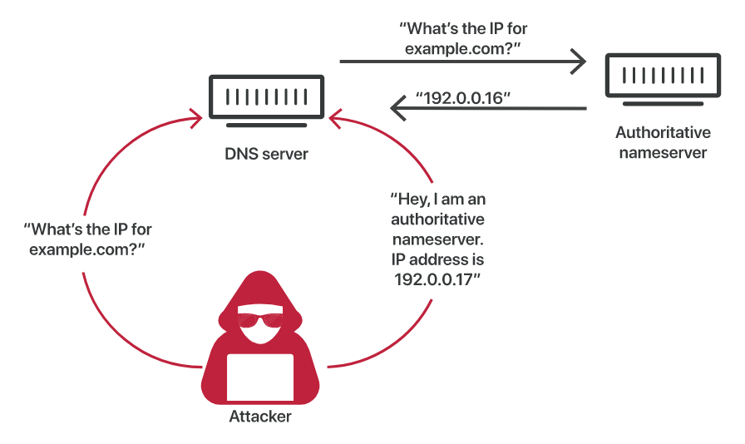
DNS spoofing
Attackers can poison DNS caches by impersonating DNS nameservers, making a request to a DNS resolver, and then forging the reply when the DNS resolver queries a nameserver.

Slide 31
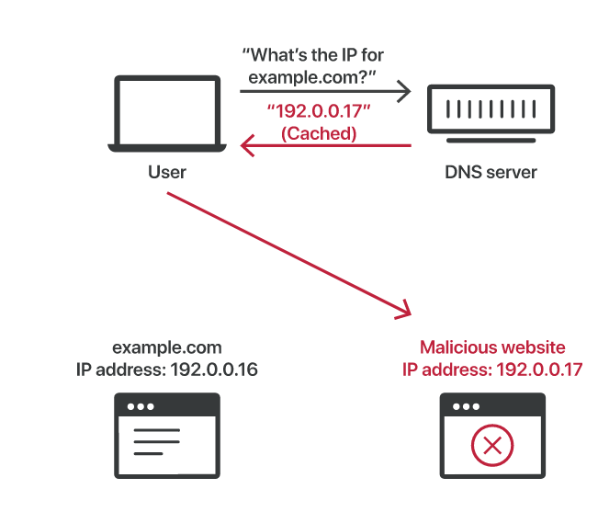
DNS spoofing

Slide 32
Decryption
A MITM attack after the attacker gains access to the victim’s encrypted data, it must be decrypted for the attacker to be able to read and use it.
Several methods might be used to decrypt the victim’s data without alerting the user or application:
HTTPS Spoofing:
HTTPS spoofing is a method for tricking your browser into thinking a certain website is safe and authentic when it’s not.
When a victim attempts to connect to a secure site, a false certificate is sent to their browser which leads them to the attacker’s malicious website instead. This gives the attacker access to any data the victim shares on that site.

Slide 33
Decryption
SSL Hijacking:
Any time you connect to an unsecure website, indicated by “HTTP” in the URL, your server automatically reroutes you to the secure HTTPS version of that site.
With SSL hijacking, the attacker uses their own computer and server to intercept the reroute, allowing them to interrupt any information passed between the user’s computer and server. This gives them access to any sensitive information the user uses during their session.

Slide 34
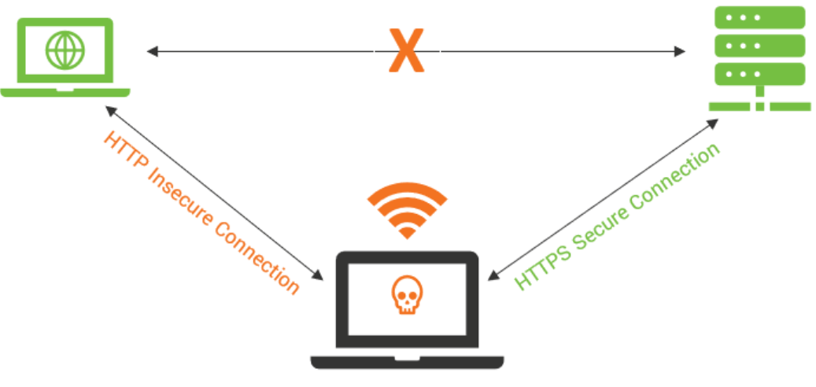
Decryption
SSL Stripping:
SSL stripping involves the attacker interrupting the connection between a user and a website.
This is done by downgrading a user’s secure HTTPS connection to an unsecure HTTP version of the website. This connects the user to the unsecure site while the attacker maintains a connection to the secure site, rendering the user’s activity visible to the attacker in an unencrypted form.

